Slide 1
https://youtu.be/2ve20PVNZ18?t=15

Slide 2
Slowly Is The Fastest Way To Get To Where You Want To Be
Eric Todd Inglert, AIA AE1100 Introduction to Architectural Engineering University of Cincinnati | Baldwin 755 | 1 Oct 2021

Slide 3
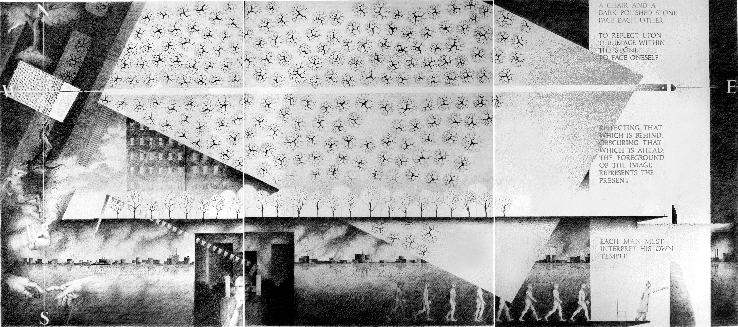

Slide 4
In his 2019 Tony acceptance speech, the then 73-year-old inspired viewers with his acceptance speech, where he laid out his cardinal rules for success: “Surround yourself with people whose eyes light up when they see you coming,” and, “Slowly is the fastest way to get to where you want to be.”
–André De Shields People often misquote his second cardinal rule, he says, and talk about where they want to “go” rather than where they want to “be.” (NPR. 2021. André de Shields)

Slide 5
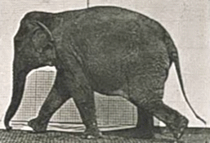
The Architect in the Room

Slide 6
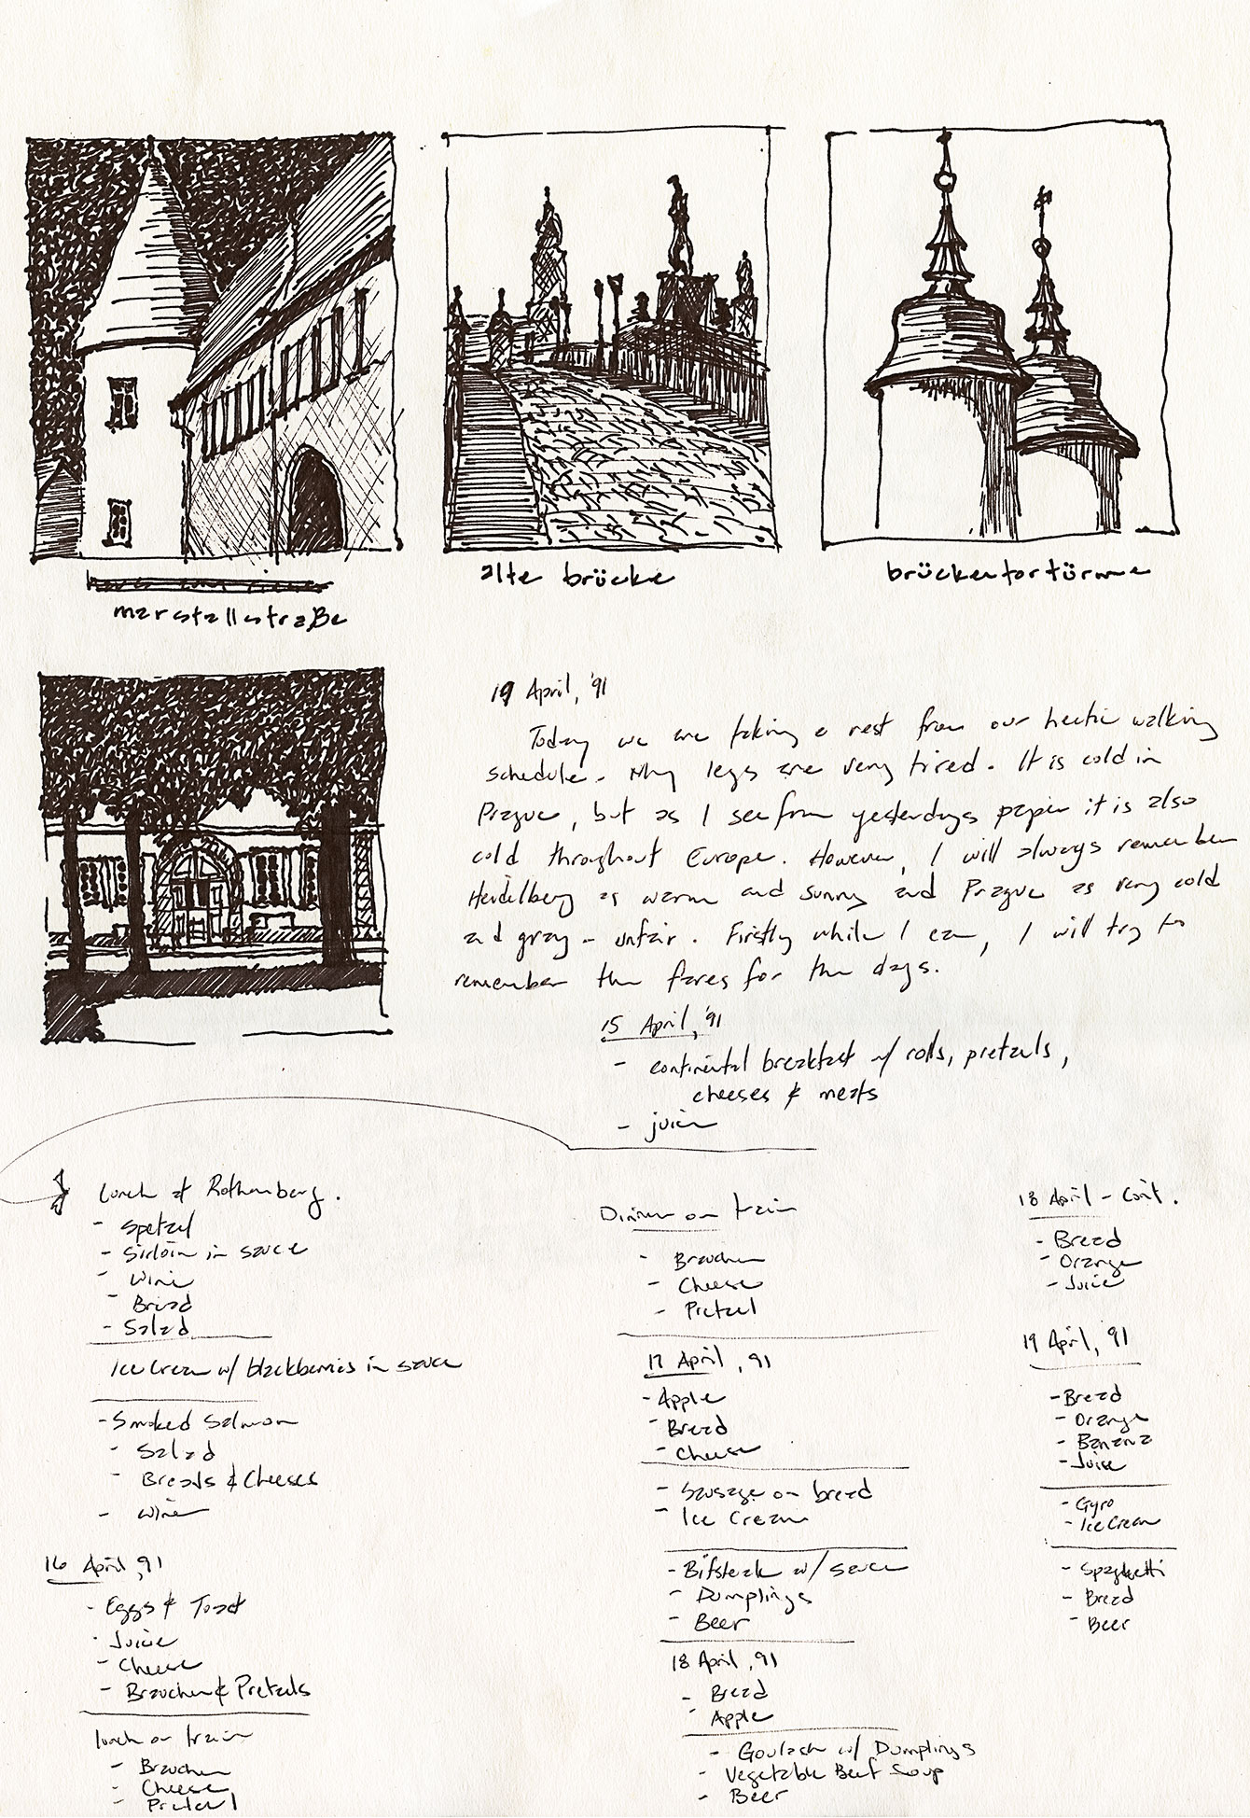
Who Do You Think You Are?
Registered architect in the State of Ohio
Associate Professor with Tenure at UC
Assistant Department Head in CAECM
BS Env. Des. and B’Arch. from BSU (1988)
MBA UC (1996)
Interested:
Design Communications Media
Architectural History and Design
Building Information Modeling
Real Estate Development and Finance
Architectural Skills 1 & 2 (AE1011-2)
AE1011 Architectural Skills 1 Spr 2022
AE1012 Architectural Skills 2 Fall 2022
ARCH4005 Architectural Studio 2 Fall 2025
On sabbatical and writing a textbook for you: Contemporary Practices in Architectural Drawing and Illustration from Cognella Academic Publishing. (Inglert 2022)

Slide 7
one’s not half two. It’s two are halves of one:
(e.e. cummings)

Slide 8

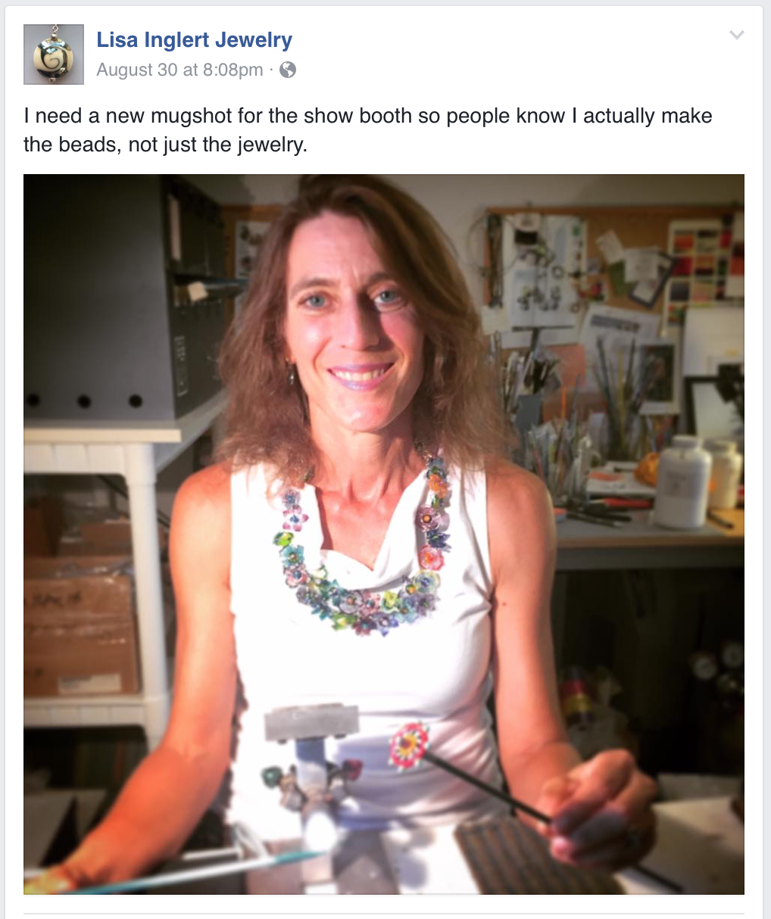

Slide 9
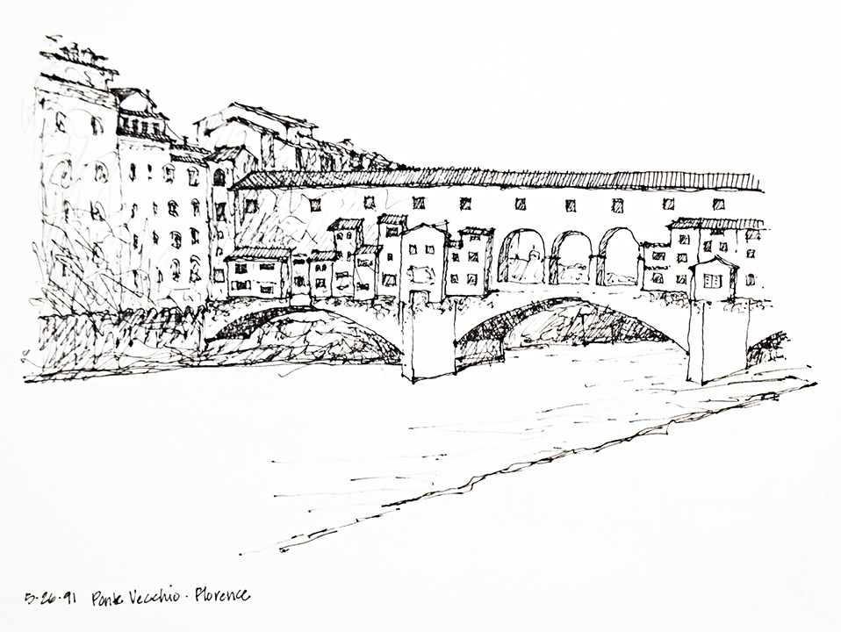

Slide 10
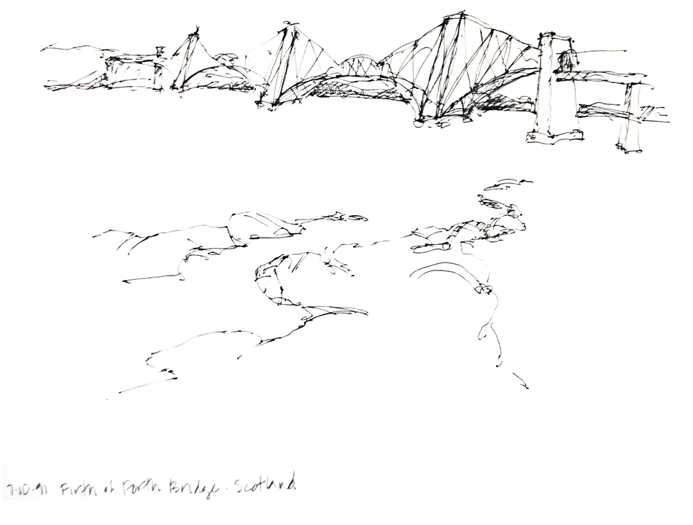

Slide 11
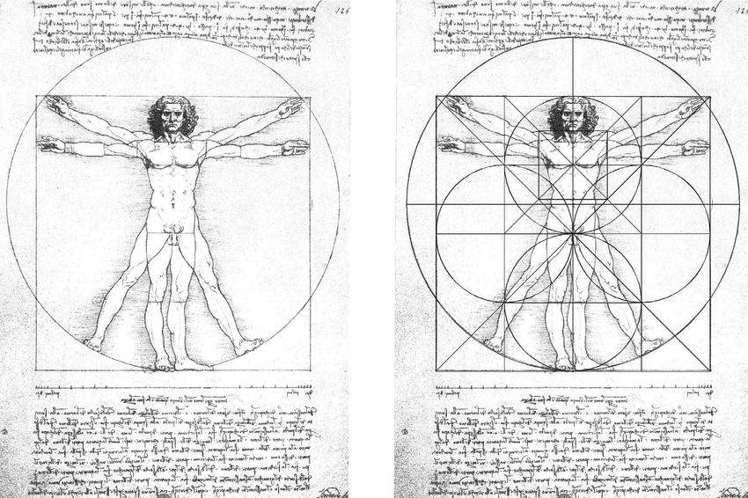
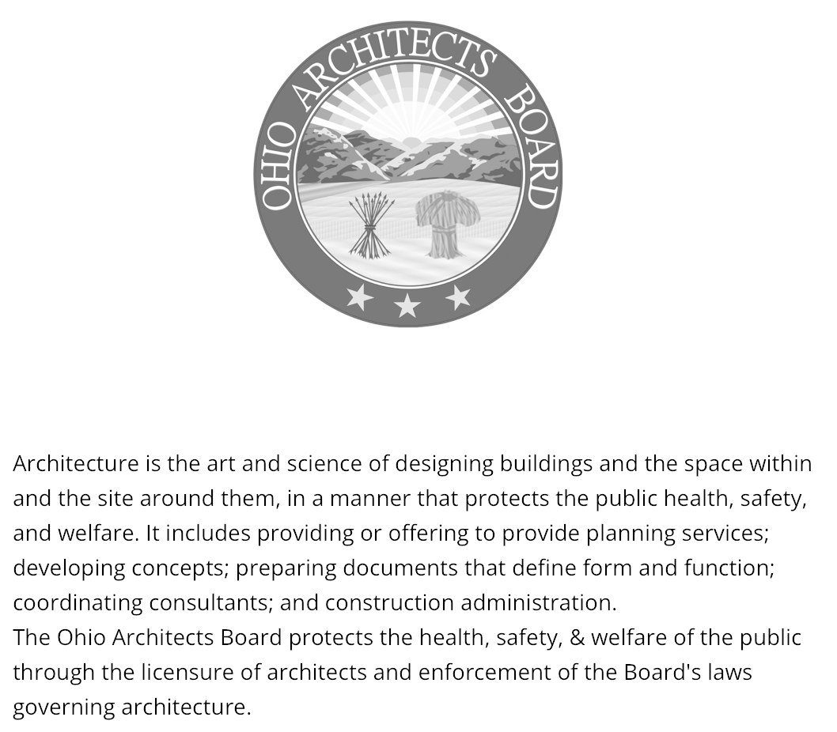
What’s on Second utilitas, firmitas and venustas

Slide 12
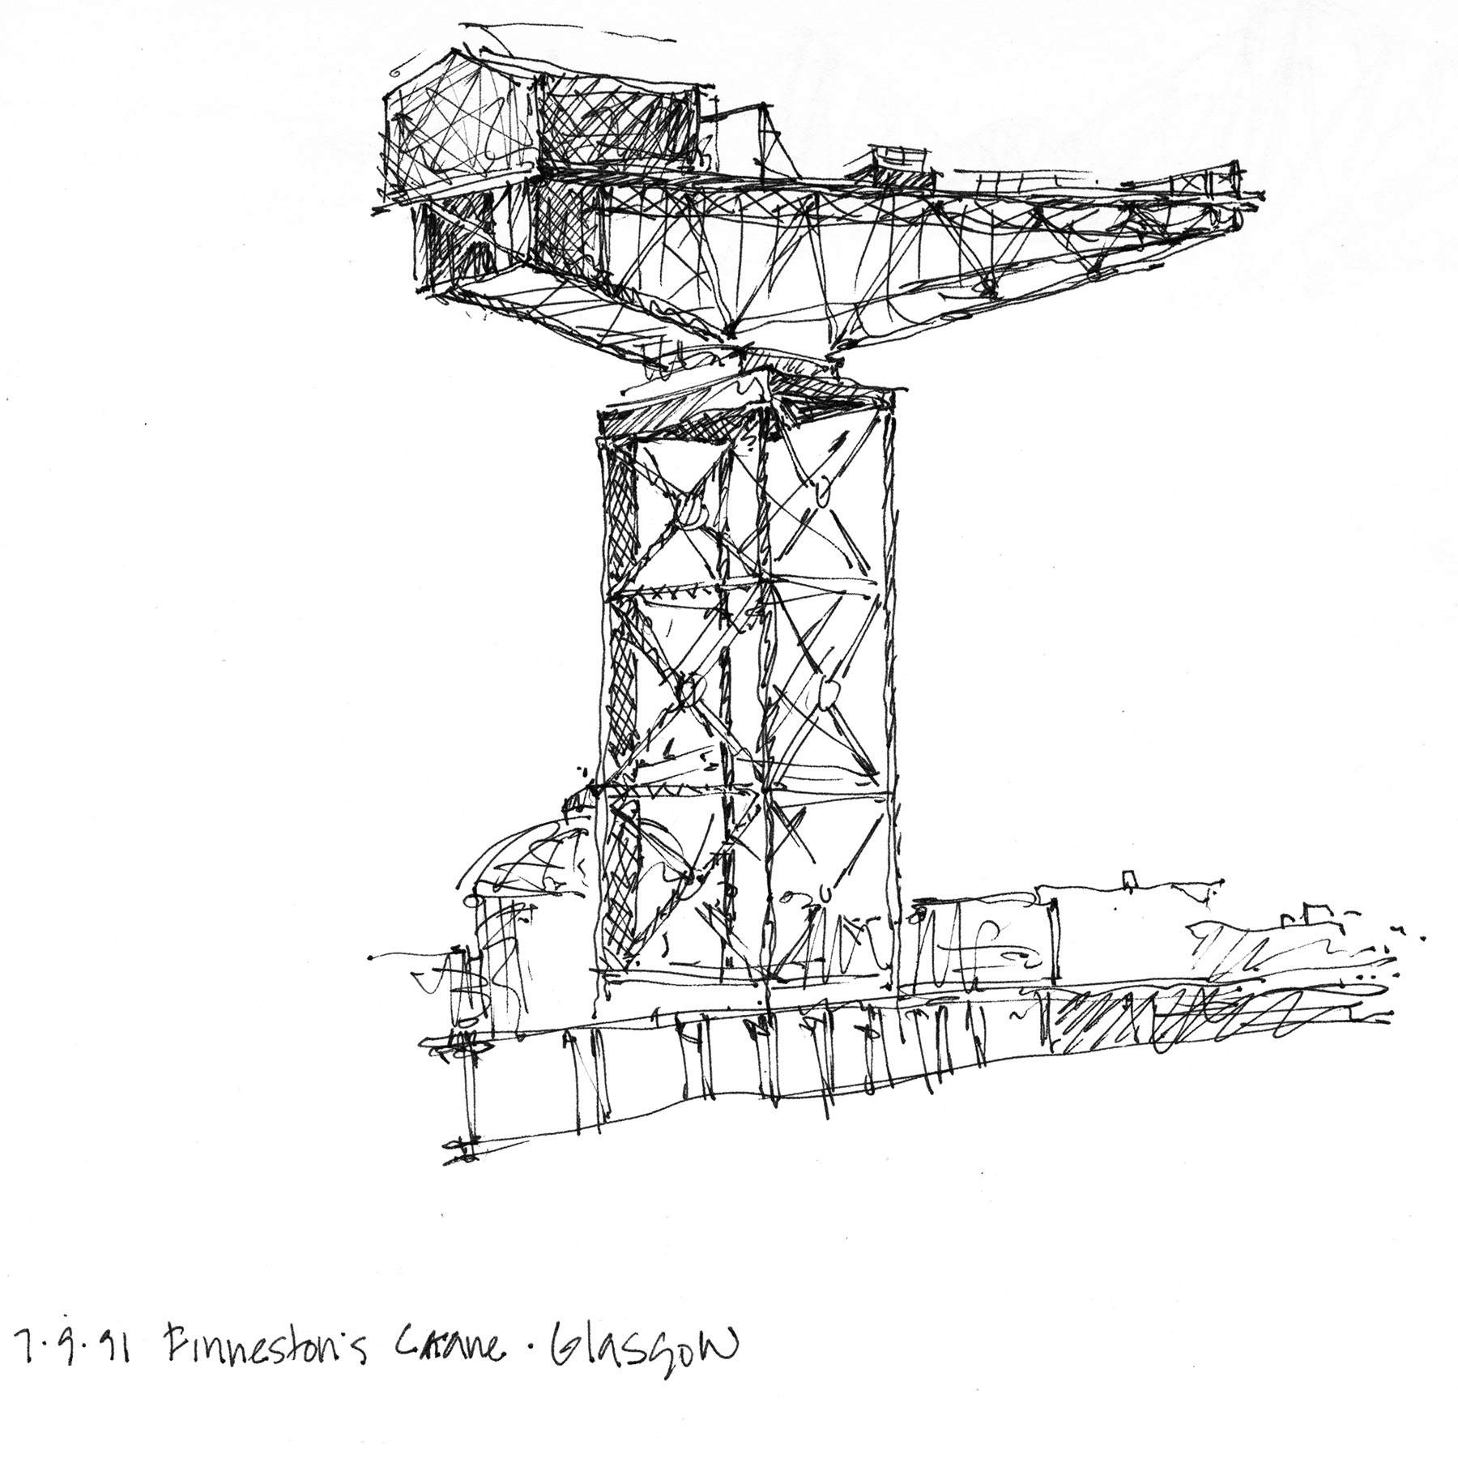

Slide 13
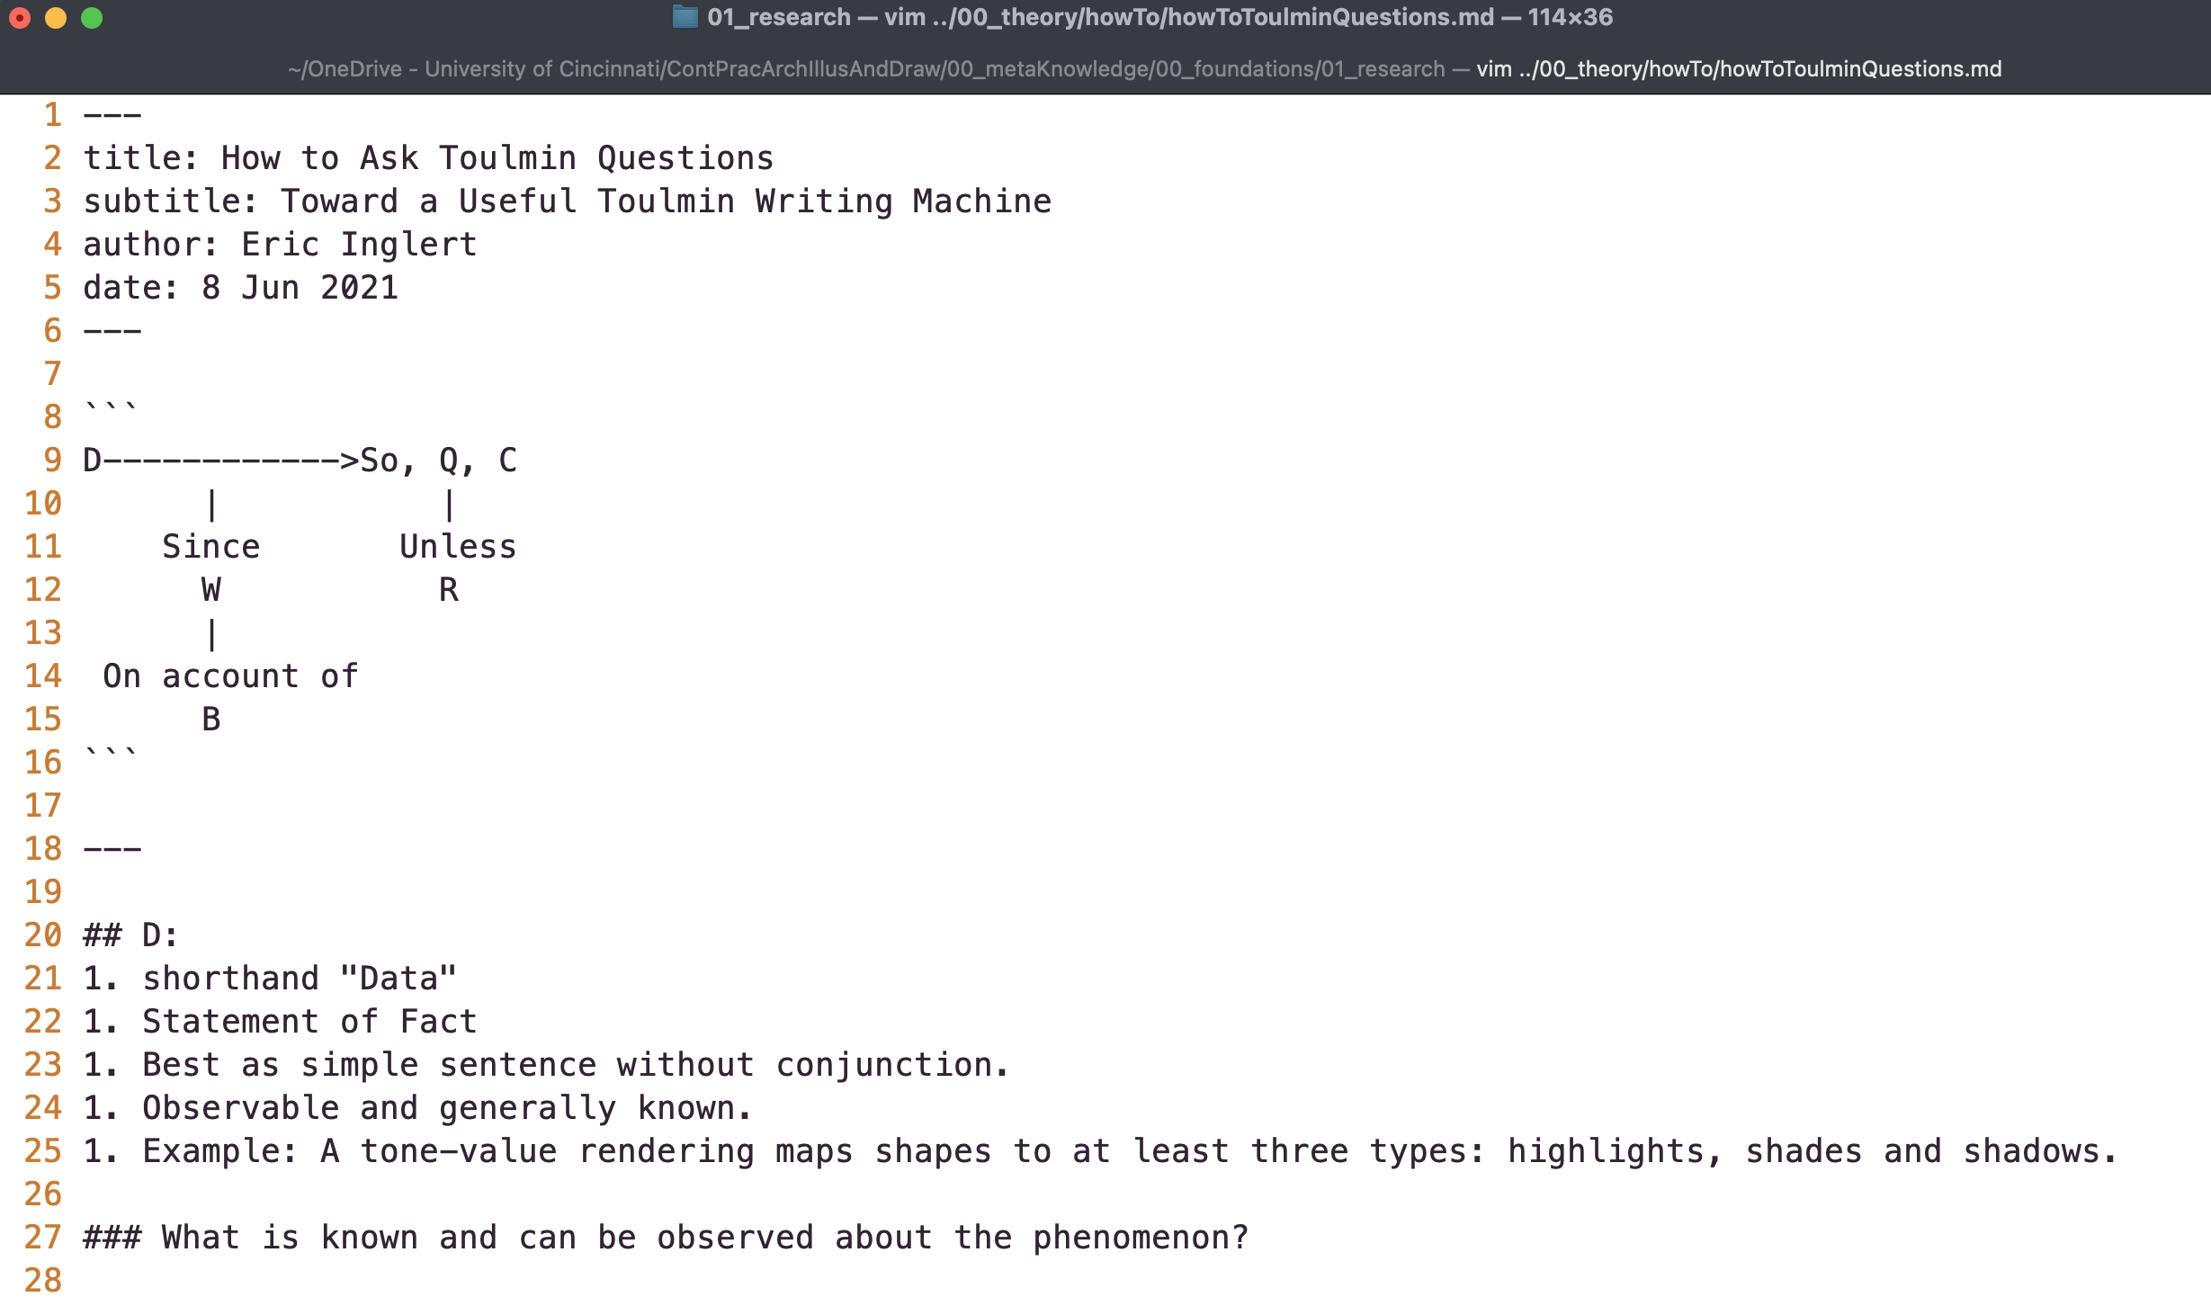
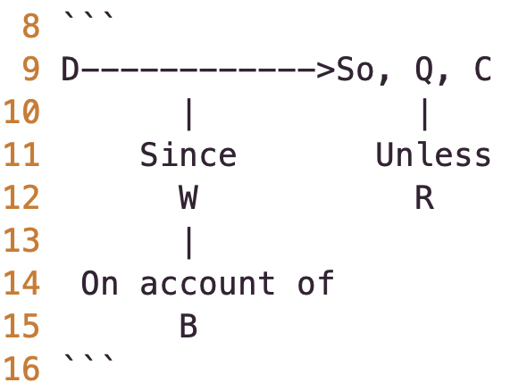
Third? I don’t know Frameworks, Heuristics and Rules of Thumb
My Toulmin Machine
Claim: What have you concluded about it all?
Data: What is observable about the phenomenon?
Warrant: How do you get there?
Backing: Why should you accept that connection?
Qualifier: How sure are you?
Rebuttal: What exceptions are there?

Slide 14
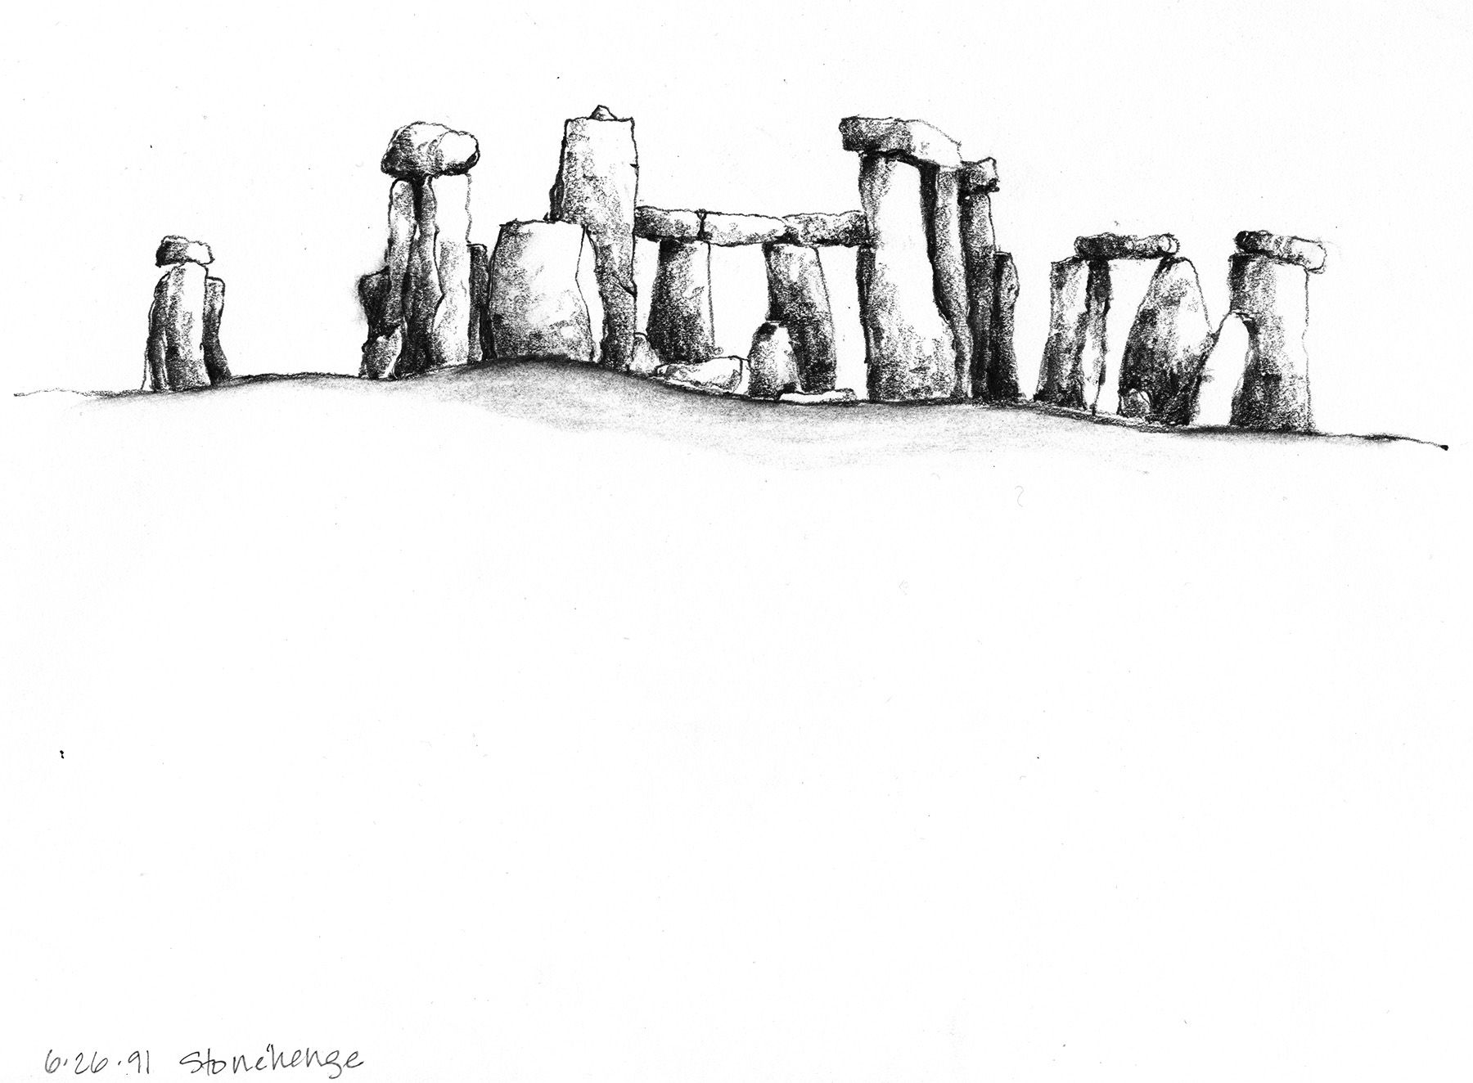

Slide 15
Architectural engineering is the application of engineering principles and technology to building design and construction. Architectural engineers work together with architects and civil engineers but are unique in both their skills and role as part of the building design team. (Civil Engineers 2021)
Learning to Live with Ambiguity
C: Design is an expansive process of asking creative questions about how to improve existing conditions. D₁: Reductionism implies that phenomena are reducible to fundamental elements. D₂: Gestalt theory implies that an organized whole is more than the sum of the elements. W: Creativity involves thinking with both objectivity and subjectivity. B: The complexity of problem solving defies simple, tidy, and singular explanations. Q: Confidence and buy-in from others about your solutions to a problem increases proportionally to the expansiveness and inclusivity of your processes. R: While problem definitions can benefit from reductive and simplifying processes, design solutions often ask more questions than are answered which can be uncomfortable.

Slide 16
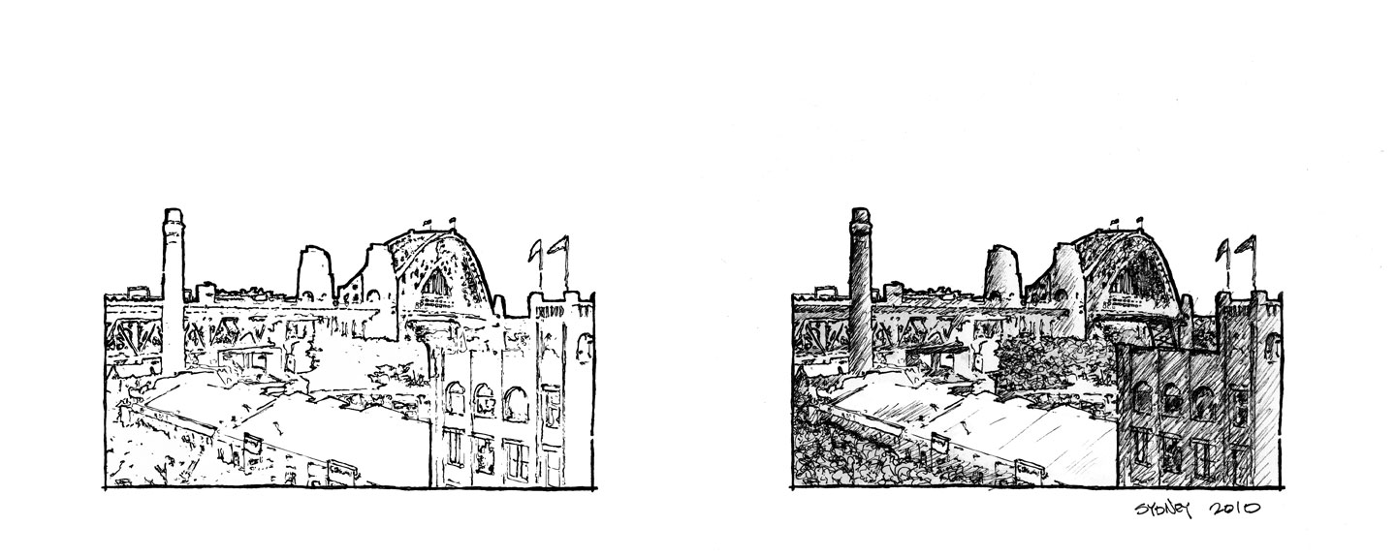

Slide 17
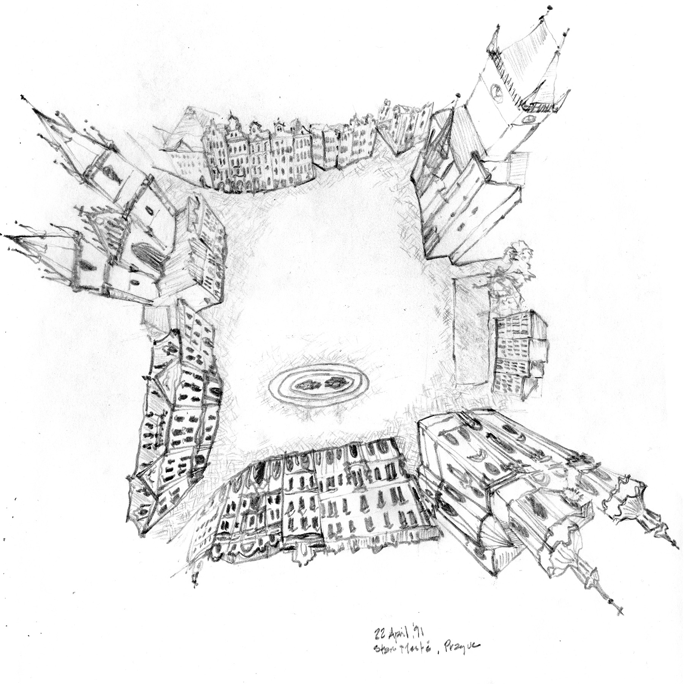

Slide 18
How Do YOU Design Your Architectural Engineering Path And Get To Where You Want To BE?

